Slide 1

Agenda
Introduction
TCS Understanding of Scope & Objective
TCS Capability
TCS Experience
TCS Solution
Resource Structure
.
Prachi to Update once the slides are finalized

Slide 2


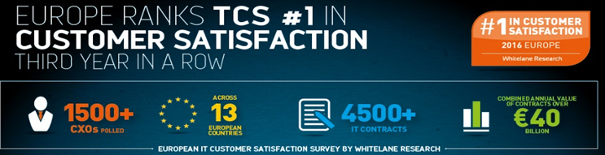

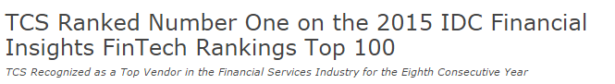
ING-TCS Relationship – 19 + years and Going Strong
By virtue of our 19+ years’ of experience working with ING, TCS has a strong understanding of ING’s ecosystem and the Way of Working
10 Countries
800+ Engineers
90 %
Current CSI
Netherlands
Belgium Germany
Serving ALL Market leaders – Netherlands, Belgium, Luxemburg
Growth Markets – Business Units in Asia
Challengers – France, Australia, Spain
Wholesale Banking
France
Italy
Spain
India
Singapore
Manila
Australia
6
7

Slide 3
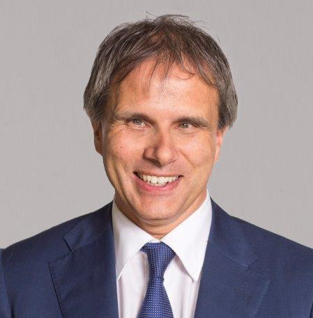
Our Understanding of your need
Onboarding process of ING SCF program is being supported by integrated IT solution hosted in third party data center(DXC) comprising of;
Customer (Buyer & Supplier) facing web portal -> Inputting & validating supplier information
Microsoft dynamics CRM tool -> Onboarding workflow & Service request handling
ING is seeking out solution to a challenge posed by impending exit from DXC data center by November 18
In the current endeavor ING wants to move out of DXC data center with no business impact.
While the primary objective is to perform like for like migration, it should be also possible to bring-in process optimization, lay down solid technology foundation for the future and handle operational processes such as IT risk, security monitoring etc
“IT has an important contribution to laying foundation for further convergence that drives faster time-to-market, improve cost efficiency and improve customer experience.”

Slide 4
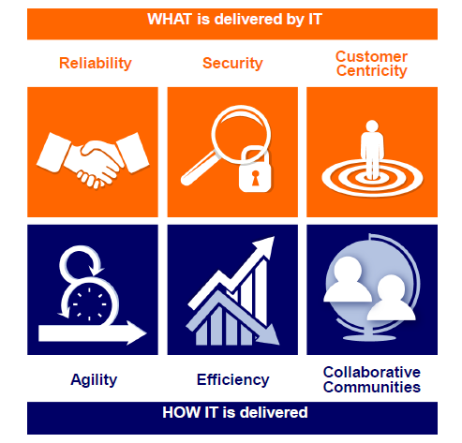
Key Solution Tenets
1
2
Strong supply chain finance capability
Extensive Pega experience
3
4
Successful Distributed Agile Way of Working
TCS learnings from similar migration & transition experiences within ING
5
Strong understanding of ING tools and processes

Slide 5

Our approach
AS - IS
TO - BE
Option 1
Key Factors
Stringent timelines
ING internal hosting processes
People scale up
Business user acquaintance with new system
Portal
Re-host the portal
Stepping Stone
Rewrite workflows in PEGA
Migrate to ING Infrastructure
Workflow
(Microsoft Dynamics)
Option 2
Infrastructure
(DXC)
Re-build the portal

Slide 6
Portal Application Re-hosting
Portal Application Rehosted in two ways in ING
TCS Engagement Objectives
Partner with a TCS to support & maintain Applications .
Ensure scalability & extensibility to meet requirements of business operations.
Develop a seamless migration process and design to allow with optimal automation to enable future release across instances.
Classification of the provisioned DTAP environment like: If a Production environment was requested then it should have automated backup already activated etc.
Modify the CI List with the details of the newly provisioned environment.
Configuration of Web Server.
Configure with CDaaS pipeline Automation in Application Installation, Smoke Testing and Packaging and Deployment.
Ensure that specific compliance and security measures are adhered to/enforced upon the environment being provisioned.
Monitoring ,Reporting and backup services to monitor the operational efficiencies on a regular basis.
Responsible for Disaster recovery plan.
Classification of the provisioned DTAP environment
ING Private Cloud
ING Data
Center
Prerequisite application software
Integration with CDaaS
A Private cloud can be termed as group of services and infrastructure accessed privately on a network.
A datacenter is a centralized repository physical or virtual which houses computer systems for management, storage and dissemination of data organized around a dedicated facility.
Backup & Monitoring
Internal Security (MIS)
ING Engagement Objectives
Source code /Binaries provided to ING from DXC.
Infrastructure provided by the ING (VM with operation System,IIS and .Net Framework).
Licensing Cost of software Provided by ING for (Operating System, Visual Studio)
Transition session and Documents to ING by DXC
Additional patching/hardening
CI List Update
Disaster Recovery Plan

Slide 7
Pega workflow creation
Preetham & Rajesh to update

Slide 8
TCS-ING Relationship (PEGA) Journey so far...
Sep’15
Jan’16
Jun’16
Jul’16
Aug’16
Oct’16
Nov’16
Dec’16
Engagement
Kick-off (FPM)
Engagement
Kick-off Pega Smart Investigate for Payments
Technical Analysis for ‘Communication via Email’
TCS becomes the single preferred vendor for PEGA at ING BE
Proposal for Upgrade of application
Offshore set-up
TCS’ PEGA Expert as Scrum Master
CDH engagement kick-off
PEGA selected as tool to Handle Case Management in WB Tech
TCS to support the upgrade and in Global Roll-out, Handle Payments Investigations
Key Highlights:
TCS is the BPM partner within WB Tech
15 FTE supporting the Communication Manager (PEGA) engagement at ING BE
5 FTE supporting WB Tech workflow automation of various business lines.
Onsite- Offshore delivery model to achieve cost benefits with 50% offshore leverage as of date
Implementation of ‘Payments Automation’ to reduce FTE's and Manual errors for handling payments investigations
Value Additions:
Recommendations for Training Plan for Business and IT teams in ING, leading to direct cost savings
Common Foundation Framework Validation and recommendations report with design gap analysis and recommendations with involvement of TCS’ Centre of Excellence
Proof of Concept for Nolio & Pega integration for Deployment Automation aligning to DevOps principles
Fixed price offshore driven work package for implementation of Communication via email to achieve cost benefits with end-to-end delivery ownership
Preetham & Rajesh to update

Slide 9

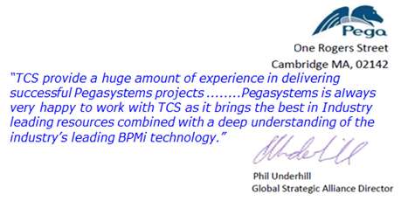
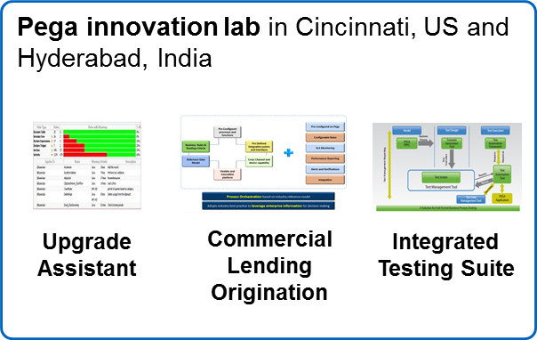
TCS’ Capabilities in PEGA
Experience
People
Innovation Labs
Services
Competency Development
R&D, Investments
More than 20 BPDM based Transformation programs delivered
40+ major active clients on PEGA
No pega Customer Attrition in
BFS
Pega implementations at TCS since 2001
1900+ Pega certified,
200+ Chordiant consultants
50+
Pega Decision Management Consultants
TCS Pega Lab in Cincinnati and Hyderabad with latest Pega platform & applications
End-to-End Pega Consulting and ADM services
Pega Upgrades achieved for 10+ customers
>90% CSI achieved
Leverage Pega Academy and ICALMS
2000+ Courses and 90,000+ Lessons Completed
50+ Pega Tools and Accelerators
Industry solutions
Sponsor of Pega Digital events and forums
Evaluated and Recommended by Gartner and Forrester for BPM services
Strategic
Consulting
Partner
Received Business Transformation in Communications, Partner Excellence Award , Customer Success in Financial Services, Market Development Award from Pegasystems
Winner of the Business Transformation Award in Communication and Media Industry by Pega Systems
TCS has highest level of Partnership with Pega, Strategic Consulting Partners
TCS is Second Largest Pega Services provider across the Globe

Slide 10



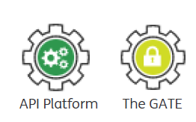






Re-imagining of customer experience
Our understanding : Technology
Hosting in IPC inline with TPA architecture
SEM-A monitoring.
Web Portal built on Polymer 2.
CDaaS & Fruityloops will be the delivery pipelines
Development will be fast and aligned with latest
technology stack
Hosting
Web Portal
Monitoring using ING tooling ELK, Grafana
& SRE Prometheus
Monitoring
User Experience
Web Components based Architecture.
Responsive Design
UX and theme inline with ING TPA
Test Automation using Selenium, cucmber.
API test automation using Karate
Automation
Interfaces
API interface inline with TPA web API
standards. API accessed via TPA Gate.
Microservice’s/API driven architecture

Slide 11
Front end & API expertise of TCS in ING
About Project
Westland Utrecht Bank (MijnWUB)
Westland Utrecht bank specializes in managing mortgages and insurance with portfolio worth € 33.8 billion.
It is Online Self service Portal thus reimagining Mortgage customer Journey through Self Service Portal for customer
Inside Business Portal (IBP)
Is strategic program to unify channel for various lines of business including Payments, Financial Market & Lending to provide omni-channel experience to customers in different countries.
It involves building functionalities for payment on IBP framework
OnePAM
Technology
Java/J2EE, Spring MVC, Rest API, Hibernate, JavaScript, ORACLE, DOJO, CDaaS, Sybase
Java8, Scala, Spring Boot, Spring-Data, Spring-Security, JPA, EMS, CXF, Polymer, AngularJS, HTML5, CSS3
Prachi to update, please add OnePAM case study
Value Delivered
Enhance the Customer experience by offering Online Channel insight, information, self service actions
Reduction in operational cost
Database for the WUB to manage profiling of the customer
Enhance the Customer service by offering omni channel experience
Reduction in operational cost

Slide 12
TCS Synergy for REF Portal
Western Utrecht Bank (MijnWUB)
Touchpoint Platform
Inside Business Portal (IBP)
Guide
OnePAM
CCN
API Platform
GATE
Mortgage customer journey re-imagined. New digital portal created aligned to TPA and GTA. Hosted on Azure
Polymer components contribution & consumption
PoC performed using Kafka & consumption of CCN
Consumption for API publication for PSD2, OnePAM
Consumption for API publication for PSD2, OnePAM
Multiple squads part of the core team
Building functionalities for payments on IBP framework
REF Portal
Product developement leveraging TPA and aligned to GTA
DevTop pattern contribution. Assist teams with IPC pattern consumption
Usage and on-boarding for delivery pipeline and ING technology standards
Involved in part creation, usage and on-boarding of teams
Model Bank
ING Private Cloud (IPC)
IT4IT
Delivery Pipeline
CDaaS & Fruityloops

Slide 13
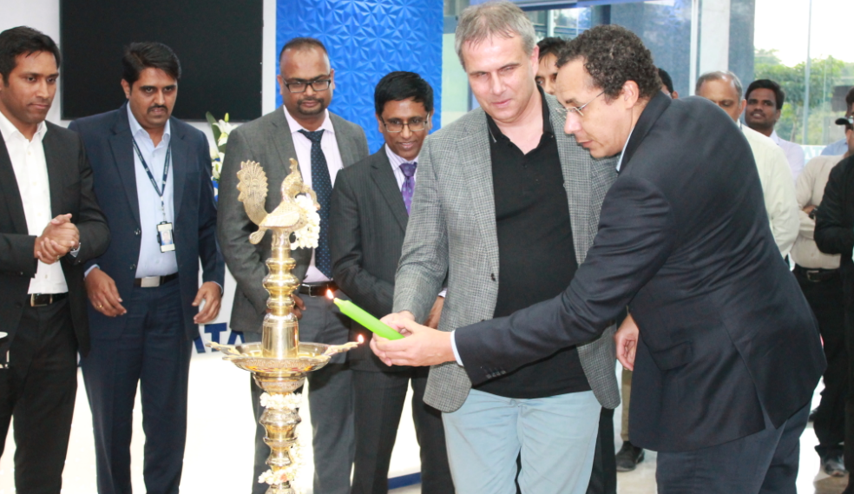
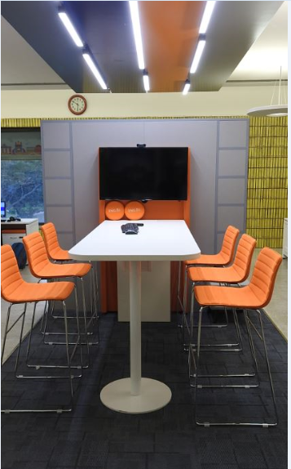
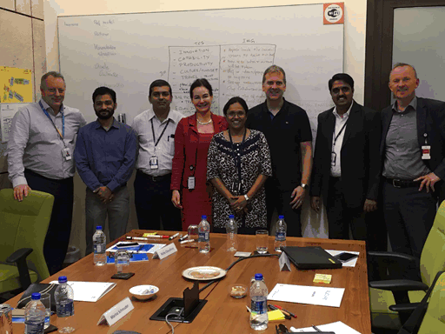

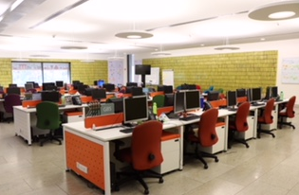
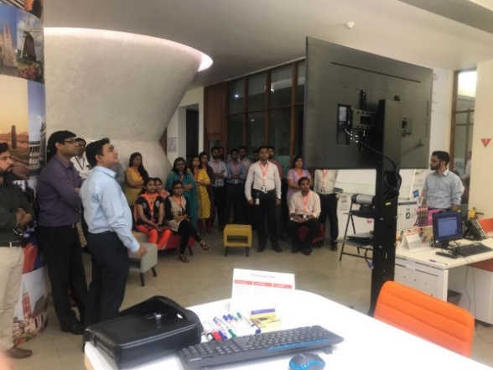

Successful Distributed Agile WoW
3

Slide 14
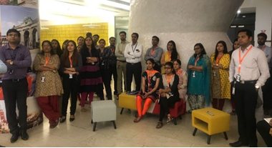
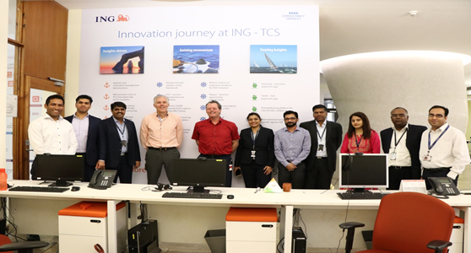
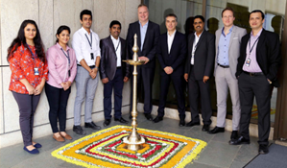
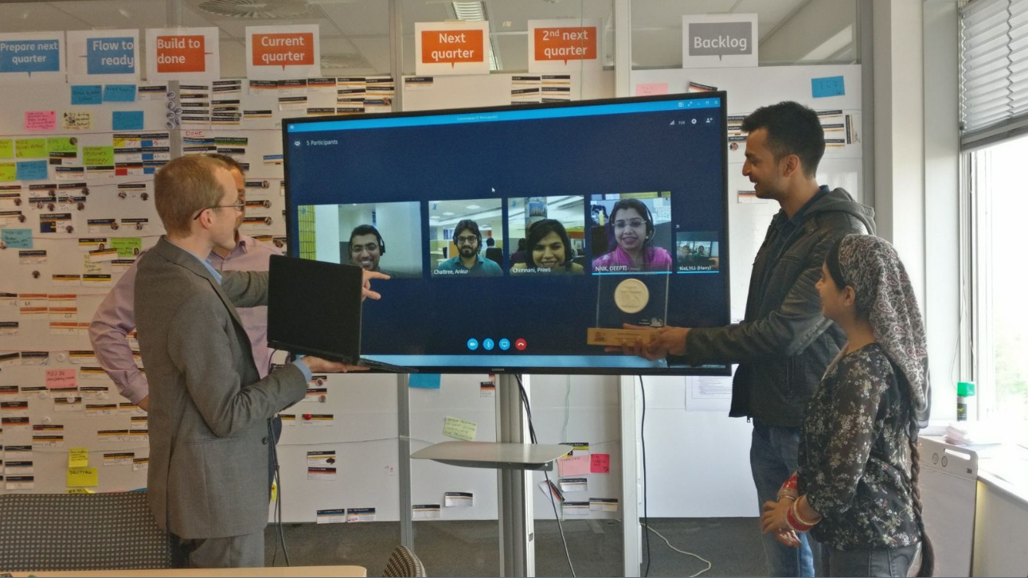
Learnings from similar transition experiences within ING
4
Teams
GIOM, WB Tech/P&OM
Vantage, WB Tech/CR&I
Electronic Banking, ING Belgium
SAP, ING Wholesale Bank Belgium
and more..
Highlights
In-house and vendor products
High offshore leverage
Varied technologies
Diverse skillsets

Slide 15
Migration Options
Arnab to discuss with Rahul Singh

Slide 16
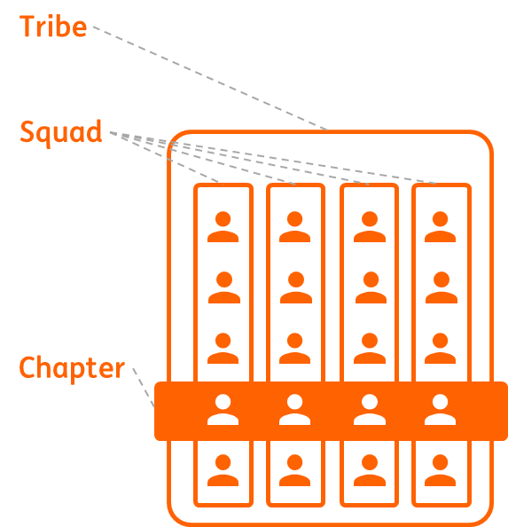

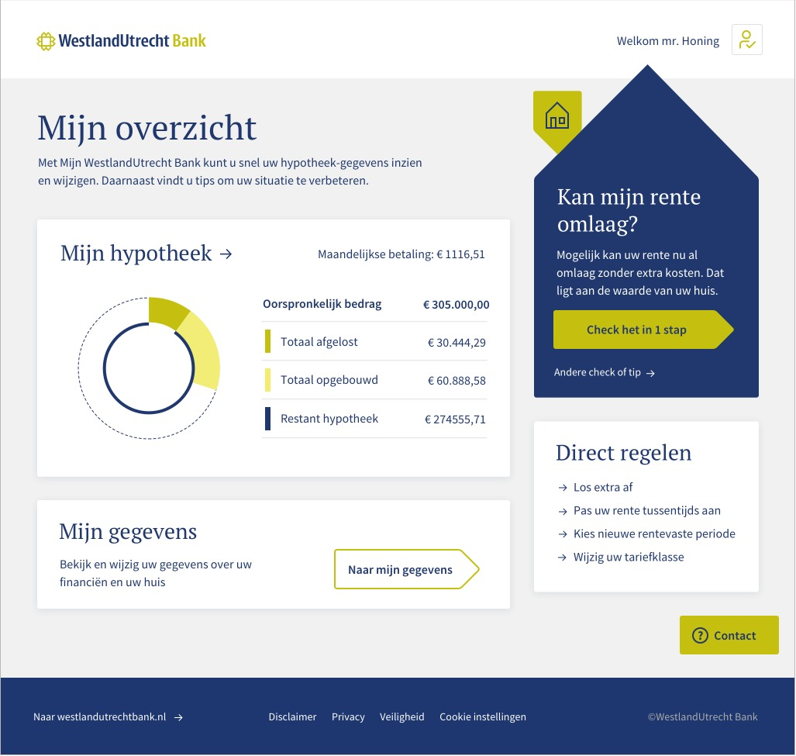

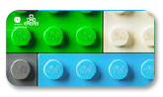

TCS understands ING technology, tools and processes
Strong understanding and implementation of ING’s One Way of Working in Distributed model
TCS Synergy in ING
Contributor &
Consumer of ING’s
Software Delivery Pipeline
Contributor &
Consumer of
ING’s TPA Platform
Strong understanding and consumer of IPC

Slide 17
Help & Clarification needed from ING
Licensing arrangement with existing technology & Infra providers
Support from existing technology & Infra providers
ING archtectural guidance on documents storing & archival solution
ING infrastructure ownership
Availability of Hardware & Software
Timely access to ING Applications
Availability of CI-CD tooling/Build Servers
Timely sign offs on Sprint deliverables
PO commitment on IT improvement plans
Ensure TCS presence in all key stakeholder meetings
Preetham & Arnab to update

Slide 18
TCS understanding of product roadmap
Bulk upload of suppliers information by Buyer
Email channel interface
Integration with back office and trading platforms
Multi-factor authentication
Enable centre storage of Customer data by integrating with OnePAM
Workflow optimization and automation

Slide 19
Our understanding : Upcoming product backlog
Bulk upload of suppliers information by Buyer
Email channel interface
Integration with back office and trading platforms
Multi-factor authentication
Enable centre storage of Customer data by integrating with OnePAM
Workflow optimization and automation

Slide 20
Way of Working
Preetham to Update

Slide 21

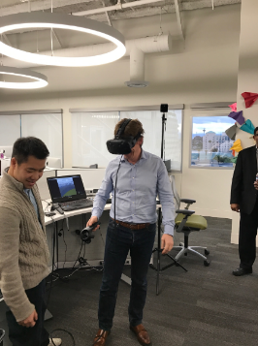

Our differentiators - TCS as your trusted partner
Trusted primary partner in ING Wholesale Banking
TCS-PEGA Global partnership and investment in PEGA innovation labs
Existing BPM partner to leverage its strong PEGA CoE and existing ING competency ( in ING Belgium and Wholesale Banking) in your transformation jouney
Presence in OnePAM positions TCS to support the transformation jouney for ING
Strong understanding and knowledge of BDD/ATDD within ING for test automation
Established partnership in WUB, IB portal,
Data and Integration squads provides
right synergy
Proven track record of Polymer based web roll-outs within ING (across business units)
ING team led by Roel Louwhoff (COO & CTO ING) visits TCS Innovation Centre in Santa Clara Getting perspective on Research in AI & Machine Learning space
Presence in SCF business and IT lending domain to help understand the business functionality
Complete knowledge of CDaaS and ING’s WoW to move to ONE ING standard
Strong Lending & SCF domain expertise with experience in similar transformations
Strong experience in ING in enabling distributed Agile way of working
Know-how of ING Private cloud (IPC)
. Fully functional Offshore delivery centre ready
TCS experience in enablement and migration from third party data centre to ING

Slide 22
Commercials
Preetham to Update

